Slide 1
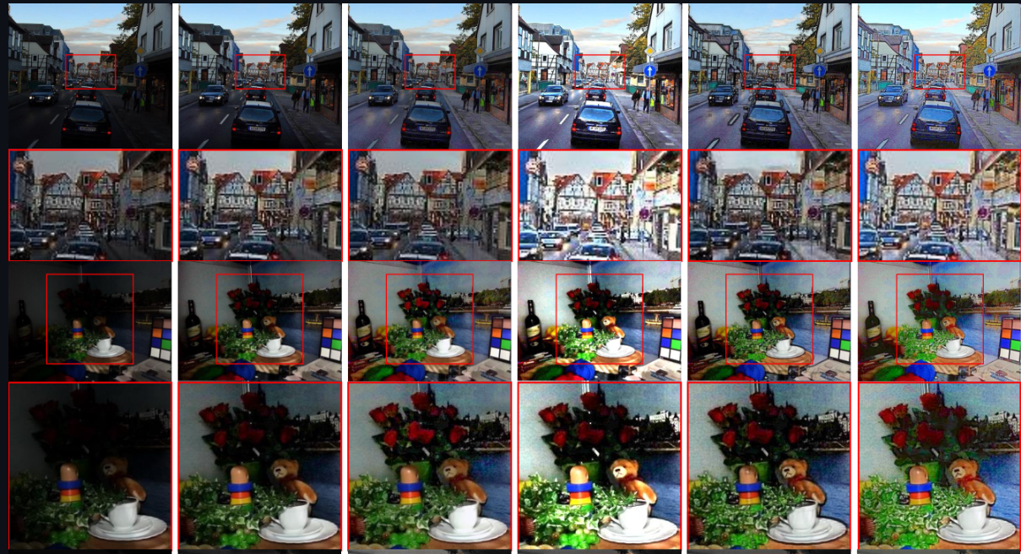
ML Methods for Object Recognition in Dark
Research project
Mentor: Dr. Sasha Apartsin
Students: Yarom Swisa and Rom Hirsch

Slide 2
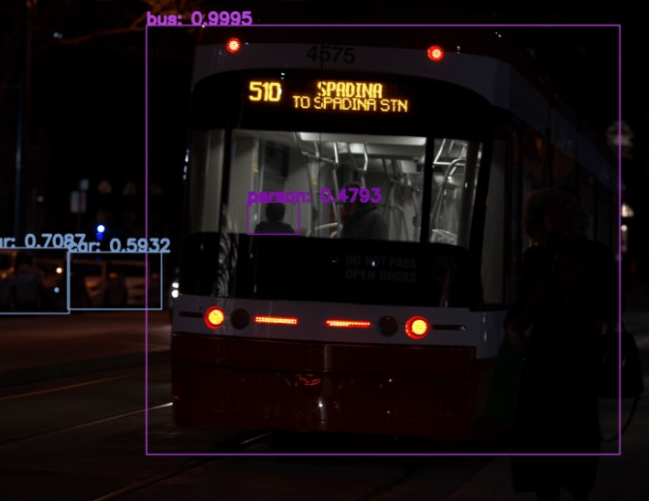
Intro
Solutions for object detection are implemented in many areas like image tagging, security footage analyzing and more.
Most used systems provide answers for this problem but a lot of them have difficulty dealing with non-ideal environments.
For example one of these problems is input of darken images.

Slide 3
Project description
In this project we want to find the best solution for dealing with the issue of images that are taken during the night.
we will evaluate different methods of coping with realistic dark images for computer vision tasks using deep learning methods.

Slide 4
Engineering challenge
Low light image is a very challenging computer vision task.
Simulate “natural” dark images for testing.
Implement different methods of NN models of big data.

Slide 5
Work plan
Review and evaluate existing solutions and methods.
Choose a proper data set to test on.
Implement methods for creating synthetic data (darken the images).
Apply preprocessing and NN models
Compare the different methods using various KPI.

Slide 6
Project products
Project book
Python code of NN methods

Slide 7
Literature
https://arxiv.org/pdf/2106.15953.pdf
  Fast Deep Learning Framework for
  Low-Light Image Enhancement with
  Noise Removal and Color Restoration
https://web.stanford.edu/class/cs231a/course_notes/01-camera-models.pdf
  Camera Models
https://www.visiononline.org/userassets/aiauploads/file/cvp_the-fundamentals-of-camera-and-image-sensor-technology_jon-chouinard.pdf
  The Fundamentals of Camera and Image Sensor Technology
https://arxiv.org/pdf/1808.04560.pdf
https://daooshee.github.io/BMVC2018website/
  Deep Retinex Decomposition for Low-Light Enhancement

Slide 8
Gant

